Slide 1
Design and Implementation of Anti-collision Algorithms for Dense RFID Systems
Hazem Elsaid
Doktorandenforum, 19.05.2016

Slide 2
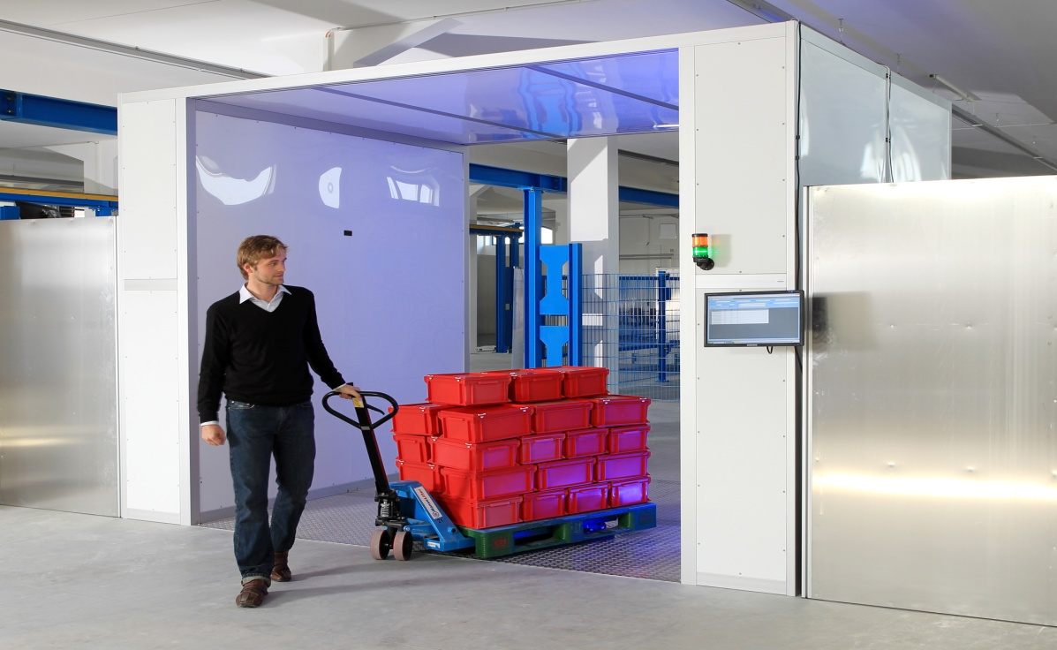
Motivation
System Model:
Single RFID Reader.
Dense RFID network with unknown
number of passive tags
Tags should be identified in the
minimum possible time
Frame Slotted ALOHA is used to maximize the reading efficiency
Taken from http://bin95.com/BarCode_RFID.htm

Slide 3
Motivation
Reader informs the tags with the current frame length
Each tag chooses random slot
L
Tag
Interrogation Zone
Reader

Slide 4
Motivation
Reader informs the tags with the current frame length
Each tag chooses random slot
Successful slot
Successful
S
L
Tag
Interrogation Zone
Reader

Slide 5
Motivation
Reader informs the tags with the current frame length
Each tag chooses random slot
Successful slot
Empty slot
No Answer
S
E
L
Tag
Interrogation Zone
Reader

Slide 6
Motivation
Reader informs the tags with the current frame length
Each tag chooses random slot
Successful slot
Empty slot
Collided slot
Performance limitation:
Empty slots
Collided slots
Multiple answer
S
E
C
L
Tag
Interrogation Zone
Reader

Slide 7






PHY-Layer Parameters
Time Aware System:
Decrease the empty slot duration
Eliminate the effect of the empty slots
Collision Recovery System
Convert collided slots to successful slots
Eliminate the effect of the collided slots
S
C
E
S
C
E
E
$$Tslot$$
$$Tslot$$
$$Tslot$$
S
C
E
S
C
E
E
$$Tk$$
$$Tk$$
$$Te$$
S
C
E
S
C
E
E
S
S
E
S
S
E
E

Slide 8

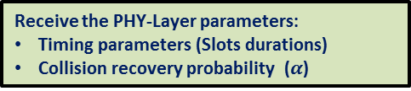
Proposed System
Modified Framed Slotted ALOHA algorithm:
Initialize: frame length
Observe: (Collided- Successful- Empty) slots
End
yes
Collided & Successful slots =0
No
Receive the PHY-Layer parameters:
Timing parameters (Slots durations)
Collision recovery probability ($α$)
Estimated number of tags ($n$)
Optimize the next frame length ($Lopt$)

Slide 9
Agenda
Proposed Cross (MAC-PHY) Layer Optimization (PhD Contribution)
Number of Tags Estimation Method
Frame Slotted ALOHA Frame Length
Adaptive Decision Collision Recovery System
PhD Summary
Patents and Publications
Time plan and future work

Slide 10


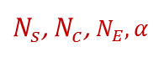
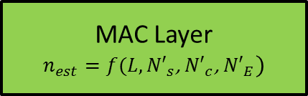
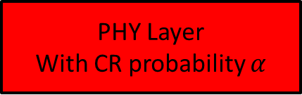
Proposed Number of Tags Estimation Method
Number of successful and collided slots before collision:
${N′}_{C}=\frac{N_{c}}{(1−α)}$
${N′}_{s}=N_{s}−\left(\frac{α}{1−α}\right)N_{c}$
${N′}_{E}=N_{E}$
Where:
$α$ is the collision recovery probability
${N′}_{s}$, ${N′}_{c}$, ${N′}_{E}$ are the number of successful, collided, and empty slots before collision recovery
$N_{s}$, $N_{c}$, $N_{E}$ are the number of successful, collided, and empty slots after collision recovery
MAC Layer
$$n_{est}=f(L,{N′}_{s}\text{, }{N′}_{c}\text{, }{N′}_{E})$$
$N_{s}\text{, }N_{c}$, $N_{E},α$
PHY Layer
With CR probability $α$
${N′}_{s}\text{, }{N′}_{c}$, ${N′}_{E}$

Slide 11







Proposed CR Aware Maximum Likelihood Tag Estimation
Proposed a posteriori distribution:
$p\left(n\backslash {L,N}_{E}{, N}_{s},N_{c},α\right)={\left(\frac{n}{L}\right)}^{{N′}_{S}}e^{−n}{\left(e^{−\frac{n}{L}}−1−\frac{n}{L}\right)}^{{N′}_{c}}$
For $n_{opt}$ $\frac{∂p\left(n\backslash {L,N}_{E}{, N}_{s},N_{c},α\right)}{∂n}=0$
After simplifications:
$$\left[\frac{1}{120}\left(L−{N′}_{c}\right)\right]n^{4}+\frac{L}{24}\left[L−{N^{′}}_{c}−\frac{{N′}_{s}}{5}\right]n^{3}+\frac{L^{2}}{6}\left[L−{N^{′}}_{c}−\frac{{N′}_{s}}{4}\right]n^{2}+\frac{L^{3}}{2}\left[L−{N^{′}}_{c}−\frac{{N′}_{s}}{3}\right]n−L^{4}\left[{N^{′}}_{c}−\frac{{N′}_{s}}{2}\right]=0$$
Using Descartes’ rules of sign:
$n_{est}=−\frac{b}{4a}−S+0.5\sqrt{−4S^{2}−2P+\frac{q}{S}}$
$$a$$
$$b$$
$$c$$
$$d$$
$$e$$
Where:
$P=\frac{8ac−3b^{2}}{8a^{2}}$
$q=\frac{b^{3}−4abc+8a^{2}d}{8a^{3}}$
$S=0.5\sqrt{−\frac{2}{3}P+\frac{1}{3a}\left(Q+\frac{∆_{0}}{Q}\right)}$
$Q=\sqrt[3]{\frac{∆_{1}+\sqrt{{∆2}_{1}^{}−4{∆3}_{0}^{}}}{2}}$
$∆_{0}=c^{2}−3bd+12ae$
$∆_{1}={2c}^{3}−9bcd+27ad^{2}−72ace$

Slide 12

Proposed CR Aware Maximum Likelihood Tag Estimation
Average percentage of estimation error comparison
Under collision recovery capability $α=0.7$

Slide 13
Agenda
Proposed Cross (MAC-PHY) Layer Optimization (PhD Contribution)
Number of Tags Estimation Method
Frame Slotted ALOHA Frame Length
Adaptive Decision Collision Recovery System
PhD Summary
Patents and Publications
Time plan and future work

Slide 14


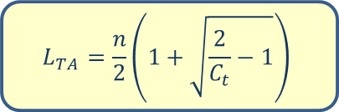

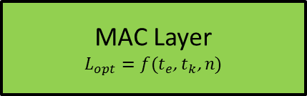
Time Aware System
Reading efficiency:
$η_{TA}=\frac{N_{s}⋅T_{s}}{N_{s}⋅T_{s}+N_{c}⋅T_{c}+N_{E}⋅T_{e}}$
For optimum frame length
$\frac{∂η_{TA}}{∂L}=0$
where : $C_{t}=\frac{T_{e}}{T_{c}}$ is the slot duration constant
After simplifications:
${\left(\frac{L_{TA}}{n}\right)}^{2}C_{t}−\left(\frac{L_{TA}}{n}\right)C_{t}+0.5\left(C_{t}−1\right)=0$
After Solving the equation and rejecting the negative solution
Proposed optimum time aware frame length:
MAC Layer
$$L_{opt}=f(t_{e}\text{,} t_{k}\text{, }n)$$
$t_{e}$, $t_{k}$
$$\left(1−\frac{n}{L_{TA}}\right)=\left(1−C_{t}\right){\left(1−\frac{1}{L_{TA}}\right)}^{n}$$
PHY Layer
$$L_{TA}=\frac{n}{2}\left(1+\sqrt{\frac{2}{C_{t}}−1}\right)$$

Slide 15

Time Aware System
Proposed closed form compared to the numerical solution for the full range of $C_{t}$:
$n=100$ tags.
$\max_{L}\left\{η_{TA}=\frac{N_{s}⋅T_{s}}{N_{s}⋅T_{s}+N_{c}⋅T_{c}+N_{E}⋅T_{e}}\right\}$
$L_{TA}=\frac{n}{2}\left(1+\sqrt{\frac{2}{C_{t}}−1}\right)$

Slide 16
Time Aware System
Mean reduction time for identical PHY environment compared to the conventional case L=n:

Slide 17

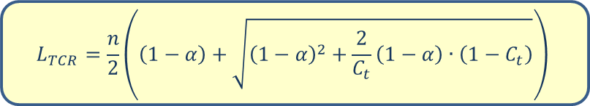

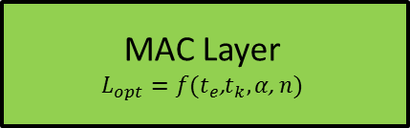
Time and Collision Recovery Aware System
Reading efficiency:
$η_{TCR}=\frac{P\left(1\right)+α∙\sum_{i=2}^{n}{P(i)}}{1+P(0)⋅\left(C_{t}−1\right)}$
For optimum frame length
$\frac{∂η_{TCR}}{∂L}=0$
The proposed final solution:
MAC Layer
$$L_{opt}=f(t_{e}\text{,}t_{k}, α\text{, }n)$$
$t_{e}$, $t_{k}, α$
PHY Layer
$$L_{TCR}=\frac{n}{2}\left(\left(1−α\right)+\sqrt{{\left(1−α\right)}^{2}+\frac{2}{C_{t}}\left(1−α\right)∙\left(1−C_{t}\right)}\right)$$

Slide 18

Time and Collision Recovery Aware System
Proposed closed form compared to the numerical solution for the full range of $C_{t}$:
$n=100$ tags.
$\max_{L}\left\{η_{TCR}=\frac{P\left(1\right)+α∙\sum_{i=2}^{n}{P(i)}}{1+P(0)⋅\left(C_{t}−1\right)}\right\}$
$L_{TCR}=\frac{n}{2}\left(\left(1−α\right)+\sqrt{{\left(1−α\right)}^{2}+\frac{2}{C_{t}}\left(1−α\right)∙\left(1−C_{t}\right)}\right)$

Slide 19
Time and Collision Recovery Aware System
Mean reduction time for identical PHY environment compared to the conventional case L=n:

Slide 20




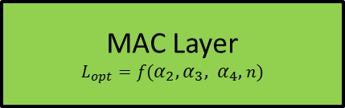
Multiple Collision Recovery Coefficients Aware System
Reading efficiency:
$η_{MCR}=P\left(1\right)+\sum_{i=2}^{n}{α_{i}∙P(i)}$
96% from collided slot is$\left\{P\left(2\right)+P\left(3\right)+P\left(4\right)\right\}$
$η_{MCR}=P\left(1\right)+α_{2}∙P(2)$+ $α_{3}∙P(3)$+${ α}_{4}∙P(4)$
For optimum frame length
$\frac{∂η_{MCR}}{∂L}=0$
The proposed final solution:
MAC Layer
$$L_{opt}=f(α_{2},α_{3}, α_{4},n)$$
$α_{2},α_{3},$ $α_{4}$
PHY Layer
$$L_{MCR}=\left(−\frac{b}{4a}−S+0.5\sqrt{−4S^{2}−2P−\frac{q}{S}}\right)⋅n$$
Where:
$P=\frac{8ac−3b^{2}}{8a^{2}}$
$q=\frac{b^{3}−4abc+8a^{2}d}{8a^{3}}$
$S=0.5\sqrt{−\frac{2}{3}P+\frac{1}{3a}\left(Q+\frac{∆_{0}}{Q}\right)}$
$Q=\sqrt[3]{\frac{∆_{1}+\sqrt{{∆2}_{1}^{}−4{∆3}_{0}^{}}}{2}}$
$∆_{0}=c^{2}−3bd+12ae$
$∆_{1}={2c}^{3}−9bcd+27ad^{2}−72ace$

Slide 21

Multiple Collision Recovery Coefficients Aware System
Proposed closed form compared to the numerical solution for the full range of $C_{t}$:
$n=100$ tags.
$\max_{L}\left\{η_{MCR}=P\left(1\right)+α_{2}∙P(2)\text{+} α_{3}∙P(3)\text{+}{ α}_{4}∙P(4)\right\}$
$L_{MCR}=\left(−\frac{b}{4a}−S+0.5\sqrt{−4S^{2}−2P−\frac{q}{S}}\right)⋅n$

Slide 22
Multiple Collision Recovery Coefficients Aware System
Mean reduction time for identical PHY environment compared to the conventional case L=n:

Slide 23




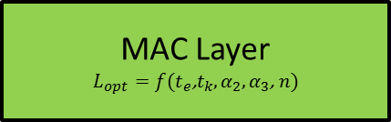
Time and Multiple Collision Recovery Coefficients Aware System
Reading efficiency:
$η_{TMCR}=\frac{P\left(1\right)+α_{2}∙P(2)+α_{3}∙P(3)}{1+P(0)⋅\left(C_{t}−1\right)}$
For optimum frame length
$\frac{∂η_{TMCR}}{∂L}=0$
The proposed final solution:
MAC Layer
$$L_{opt}=f(t_{e}\text{,}t_{k},α_{2},α_{3}\text{, }n)$$
$t_{e}$, $t_{k},α_{2},α_{3}$
PHY Layer
$$L_{TMCR}=\left(−\frac{b}{4a}−S+0.5\sqrt{−4S^{2}−2P−\frac{q}{S}}\right)⋅n$$
Where:
$P=\frac{8ac−3b^{2}}{8a^{2}}$
$q=\frac{b^{3}−4abc+8a^{2}d}{8a^{3}}$
$S=0.5\sqrt{−\frac{2}{3}P+\frac{1}{3a}\left(Q+\frac{∆_{0}}{Q}\right)}$
$Q=\sqrt[3]{\frac{∆_{1}+\sqrt{{∆2}_{1}^{}−4{∆3}_{0}^{}}}{2}}$
$∆_{0}=c^{2}−3bd+12ae$
$∆_{1}={2c}^{3}−9bcd+27ad^{2}−72ace$

Slide 24

Time and Multiple Collision Recovery Coefficients Aware System
Proposed closed form compared to the numerical solution for the full range of $C_{t}$:
$n=100$ tags.
$\max_{L}\left\{η_{TMCR}=\frac{P\left(1\right)+α_{2}∙P(2)+α_{3}∙P(3)}{1+P(0)⋅\left(C_{t}−1\right)}\right\}$
$L_{MCR}=\left(−\frac{b}{4a}−S+0.5\sqrt{−4S^{2}−2P−\frac{q}{S}}\right)⋅n$

Slide 25
Time and Multiple Collision Recovery Coefficients Aware System
Mean reduction time for identical PHY environment compared to the conventional case L=n:

Slide 26
Agenda
Proposed Cross (MAC-PHY) Layer Optimization (PhD Contribution)
Number of Tags Estimation Method
Frame Slotted ALOHA Frame Length
Adaptive Decision Collision Recovery System
PhD Summary
Patents and Publications
Time plan and future work

Slide 27
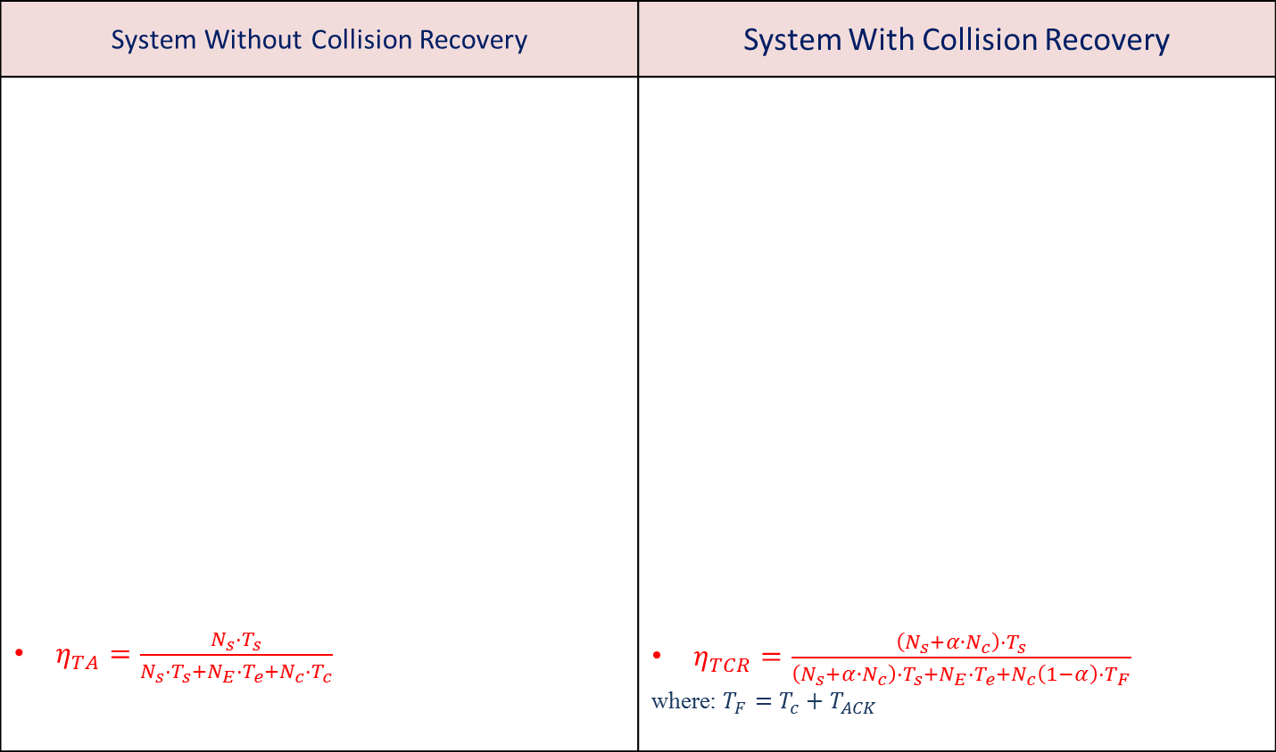
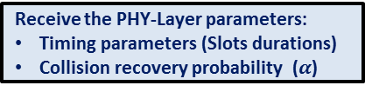
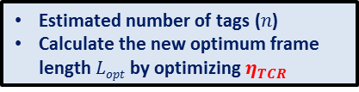
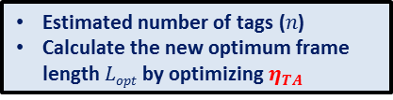
Adaptive Decision Collision Recovery System
System Without Collision Recovery | System With Collision Recovery
$η_{TA}=\frac{N_{s}⋅T_{s}}{N_{s}⋅T_{s}+N_{E}⋅T_{e}+N_{c}⋅T_{c}}$ | $η_{TCR}=\frac{\left(N_{s}+α∙N_{c}\right)⋅T_{s}}{\left(N_{s}+α∙N_{c}\right)⋅T_{s}+N_{E}⋅T_{e}+N_{c}\left(1−α\right)⋅T_{F}}$ where: $T_{F}=T_{c}+T_{ACK}$
Initialize: frame length
Initialize: frame length
Observe: (Collided- Successful- Empty) slots
Observe: (Collided- Successful- Empty) slots
End
yes
Collided & Successful slots =0
End
yes
Collided & Successful slots =0
No
No
Receive the PHY-Layer parameters:
Timing parameters (Slots durations)
Receive the PHY-Layer parameters:
Timing parameters (Slots durations)
Collision recovery probability ($α$)
Estimated number of tags ($n$)
Calculate the new optimum frame length $Lopt$ by optimizing $η_{TA}$
Estimated number of tags ($n$)
Calculate the new optimum frame length $Lopt$ by optimizing $η_{TCR}$

Slide 28

Adaptive Decision Collision Recovery System
Total Reading Time for 100 tags:
$$α_{critical}$$

Slide 29
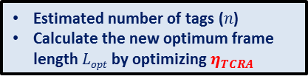


Adaptive Decision Collision Recovery System
Proposed Adaptive Decision FSA Algorithm
Initialize: frame length
Observe: (Collided- Successful- Empty) slots
End
yes
Collided & Successful slots =0
No
Receive the PHY-Layer parameters:
Timing parameters (Slots durations)
Collision recovery probability ($α$)
yes
$η_{TA}$> $η_{TCRA}$
No
Estimated number of tags ($n$)
Calculate the new optimum frame length $Lopt$ by optimizing $η_{TA}$
Estimated number of tags ($n$)
Calculate the new optimum frame length $Lopt$ by optimizing $η_{TCRA}$

Slide 30

Adaptive Decision Collision Recovery System
Total Reading Time comparison for system with random collision recovery probability $α∈[0,1]$:

Slide 31
Agenda
Proposed Cross (MAC-PHY) Layer Optimization (PhD Contribution)
Number of Tags Estimation Method
Frame Slotted ALOHA Frame Length
Adaptive Decision Collision Recovery System
PhD Summary
Patents and Publications
Time plan and future work

Slide 32
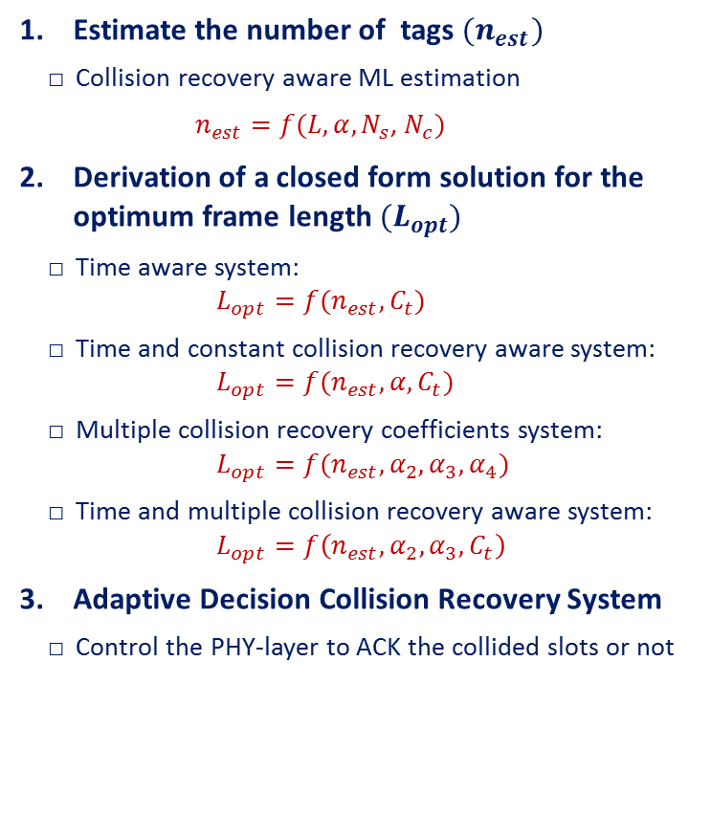



Main Contribution of my PhD Thesis
Estimate the number of tags ${(n}_{est})$
Collision recovery aware ML estimation
$n_{est}=f(L,α,N_{s}\text{, }N_{c})$
Derivation of a closed form solution for the optimum frame length${ (L}_{opt})$
Time aware system: $L_{opt}=f(n_{est},C_{t})$
Time and constant collision recovery aware system: $L_{opt}=f(n_{est},α,C_{t})$
Multiple collision recovery coefficients system: $L_{opt}=f(n_{est}, α_{2},α_{3},α_{4})$
Time and multiple collision recovery aware system: $L_{opt}=f\left(n_{est}, α_{2},α_{3},C_{t}\right)$
Adaptive Decision Collision Recovery System
Control the PHY-layer to ACK the collided slots or not
MAC Layer
$${(n}_{est}{ ,L}_{opt})$$
Adaptive
Decision
$t_{e}$, $t_{k}, α$
$L\text{, }N_{s}\text{, }N_{c}$, $N_{E}$
PHY Layer

Slide 33
Agenda
Proposed Cross (MAC-PHY) Layer Optimization (PhD Contribution)
Number of Tags Estimation Method
Frame Slotted ALOHA Frame Length
Adaptive Decision Collision Recovery System
PhD Summary
Patents and Publications
Time plan and future work

Slide 34
Conference Papers
Hazem A. Ahmed , Hamed Salah, Joerg Robert, and Albert Heuberger, ‘‘A New Optimization Criteria For Frame Slotted ALOHA Utilizing Time and The Collision Recovery Coefficients’’ Smart SysTech 2015, Achen, Germany
Hamed Salah, Hazem A. Ahmed, Joerg Robert, and Albert Heuberger, ‘‘FFT Based Rate Estimation for UHF RFID Systems ’’ Smart SysTech 2015, Achen, Germany
Hamed Salah, Hazem A. Ahmed, Robert Joerg, Albert Heuberger, ‘’FFT Based Rate Estimation for UHF RFID Systems‘’ Smart SysTech 2015
Hazem A. Ahmed, Hamed Salah, Robert Joerg, Albert Heuberger, ‘’A New Optimization Criteria For Frame Slotted ALOHA Utilizing Time And The Collision Recovery Coefficients’’ Smart SysTech 2015
Hazem A. Ahmed, Hamed Salah, Robert Joerg, Albert Heuberger, ''Backwards Compatible Improvement of the EPCglobal Class 1 Gen 2 Standard'' IEEE RFID TA 2015
Hazem A. Ahmed, Hamed Salah, Robert Joerg, Albert Heuberger, ''A Closed Form Solution for Frame Slotted ALOHA Utilizing Time and Multiple Collision Recovery Coefficients'' IEEE Radio Wireless Week 2016
Hamed Salah, Hazem A. Ahmed, Robert Joerg, Albert Heuberger, ''Maximum Likelihood Decoding for Non-Synchronized UHF RFID Tags'' IEEE Radio Wireless Week 2016
Hazem A. Ahmed, Hamed Salah, Robert Joerg, Albert Heuberger, 'Time Aware Closed Form Frame Slotted ALOHA Frame Length Optimization'' IEEE Wireless Communications and Networks Conference 2016

Slide 35
Journal Papers
Published Journals
Hazem A. Ahmed, Hamed Salah, Robert Joerg, Albert Heuberger, ‘’An Optimum Closed Form ALOHA Frame Length for Multiple Collision Recovery Coefficients’’ IEEE System Journal 2016
Hamed Salah, Hazem A. Ahmed, Robert Joerg, Albert Heuberger, ''A Time and Capture Probability Aware Closed Form Frame Slotted ALOHA Frame Length Optimization'' IEEE Communication Letters 2015
Hamed Salah, Hazem A. Ahmed, Robert Joerg, Albert Heuberger, ‘’Performance Evaluation of Rate Estimation for UHF RFID Systems’’ International Journal of RF Technologies: Research and Applications
Submitted Journals
Hazem A. Ahmed, Hamed Salah, Robert Joerg, Albert Heuberger, “A Closed Form Collision Recovery Aware Tag Population Estimator for RFID Systems” IEEE Communication Letters
Journals under construction
H. Salah, H. A. Ahmed, J. Robert and A. Heuberger “Multiple Antennas Collision Recovery Receiver Based on Stimulating The Rate Tolerance for UHF RFID Systems” IEEE Systems Journal (90% finished)

Slide 36
Patents
Hazem Elsaid, Hamed Kenawy, Robert Joerg, Albert Heuberger, Wolfram Strauß "Reader and tag", EU Patent Application 15166768.0-1811.
Hamed Kenawy, Hazem Elsaid, Robert Joerg, Albert Heuberger, Wolfram Strauß "RFID READER AND METHOD FOR ADJUSTING A FRAME LENGTH OF AN RFID SYSTEM COMPRISING AN RFID READER”, EU Patent Application 15166802.7-1811. (Pending)
Hazem Elsaid, Hamed Kenawy, Robert Joerg, Albert Heuberger, Wolfram Strauß " RFID Reader and Method for Recognizing RFID tags", EU Patent Application EP16155476.1. (Pending)
Hamed Kenawy, Hazem Elsaid, Robert Joerg, Albert Heuberger, Wolfram Strauß " RFID Tag and RFID Reader " , EU Patent Application EP16155475.3 (Pending)

Slide 37
Agenda
Proposed Cross (MAC-PHY) Layer Optimization (PhD Contribution)
Number of Tags Estimation Method
Frame Slotted ALOHA Frame Length
Adaptive Decision Collision Recovery System
PhD Summary
Patents and Publications
Time plan and future work

Slide 38
Time Plan and Future Work
 | Work Milestone | Period #1 04.2013 – 9.2013 | Period #2 10.2013 – 9.2014 | Period #3 10.2014 – 9.2015 | Period #4 10.2015 – 6.2016 | Period #4 7.2016 – 7.2017
WP1 | Specify a concrete path for my Thesis (literature review)
WP2 | - Frame length optimization (Time and Collision recovery aware systems) - Two conference papers and one journal paper
WP3 | - Collision recovery aware Tag Estimation - Two patents, 4 conference papers, and one journal paper
WP4 | - Adaptive Decision Collision Recovery System - 2 Conference papers, 1 Journal paper, two patents, and two submitted journal papers
WP5 | - Ph.D. Thesis writing - Ph.D. Examination
Done
Expected
Conference paper
Journal paper
Patents

Slide 39

Thanks for your kind attention!
Hazem.a.elsaid@fau.de

